Slide 1
Gender Pay Gap
DSC 530 Final Project
By: Jahedur Rahman

Slide 2
Data Set used
Data set taken from glassdoor.
Income for different job titles based on gender
Created on 2020-09-12
https://www.kaggle.com/nilimajauhari/glassdoor-analyze-gender-pay-gap

Slide 3
Statistical Question/Hypothesis
Do other variables impact income more than gender?

Slide 4
Variables Used
Gender: Each person's gender; Male=0, Female=1
Age: Each person’s age; 18-65 years
Education: The level of education each person finished; High School=0, College=1, Masters=2, PhD=3
Dept: The line of work each person is working in; Sales=0, Operations=1, Administration=2, Management=3, Engineering=4
Seniority: The amount of experience each person has; number of years worked, 1-5 years
BasePay: annual basic income in USD

Slide 5
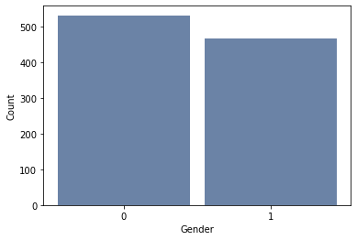
Gender
No outliers
0 is male, 1 is female
532 males
468 females
1000 total

Slide 6
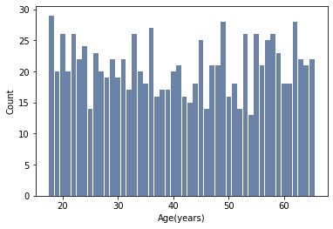
Age
No outliers
Age range 18-65 years old
Mean age 41
Mode age 18
There is no skew

Slide 7
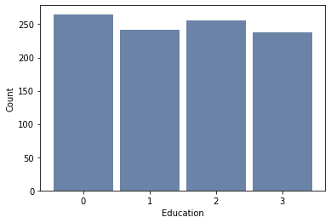
Education
No outliers
0 is High School, 1 is College, 2 is Masters, 3 is PhD
265 High School graduates
241 College graduates
256 Masters graduates
238 PhD graduates
1000 total
Mode is High School
No skew

Slide 8
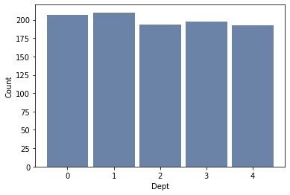
Dept
No outliers
0 is Sales, 1 is Operations, 2 is Administration, 3 is Management, 4 is Engineering
207 in Sales
210 in Operations
193 in Administration
198 in Management
192 in Engineering
1000 total
Mode is Operations
No skew

Slide 9
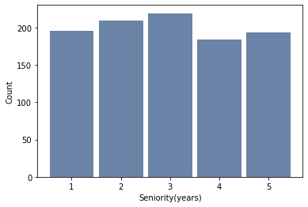
Seniority
No outliers
Seniority range 1-5 years
Mean seniority 3 years
Mode seniority 3 years
No skew

Slide 10
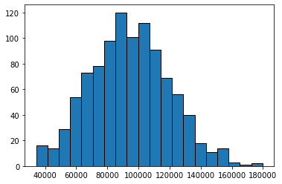
BasePay
No outliers
BasePay range 34,208 - 179,726
Mean is 94,472.65
Mode is 85,139.30 - 92,415.20
No skew

Slide 11
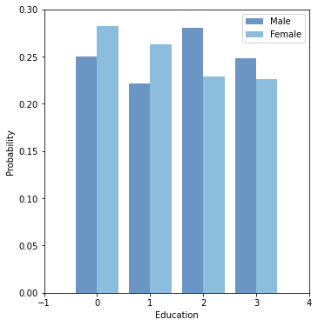
PMF Gender and Education
Sample was split based on Gender to explore differences in Education.
Males are more likely to complete Post graduate degrees like Masters and PhD
Females are more likely to graduate with a High School and College degree

Slide 12
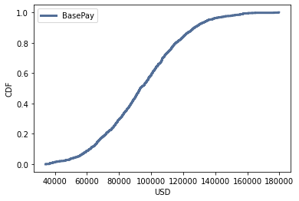
CDF BasePay
Most of the people earned between 60,000 and 120,000
This is about 70%
About 20% earn more than 120,000
Finding out how many males and how many females are earning above 120,000 could be crucial in answering the question.

Slide 13
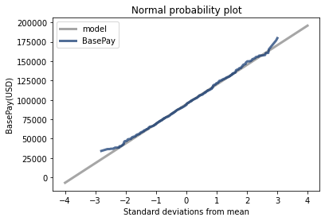
Normal Probability Plot
Plot is normal
Data fits the model very well
The normal model describes the distribution well for most of standard deviations from the mean
The tails are slightly off

Slide 14
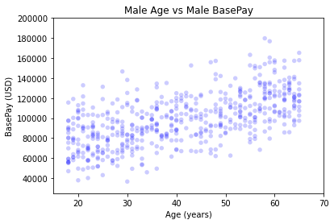
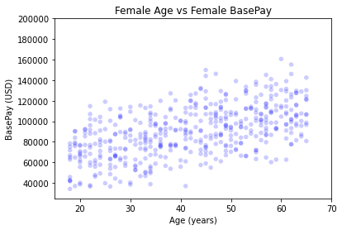
Scatter Plots
Sample was split based on Gender to explore differences in Age vs BasePay.
Both show as Age increases BasePay increases
Male BasePay range:
36,642.00 – 179,726.00
Female BasePay range:
34,208.00 – 160,614.00

Slide 15
Covariance and Pearson’s Correlation
Covariance between Age and BasePay:
Male: 224691.71
Female: 184204.17
Pearson’s Correlation between Age and BasePay:
Male: 0.598
Female: 0.547
The Pearson’s Correlation tells us that there is a relationship between Age and BasePay. It is a little bit stronger for male gender than female gender, but the difference is very small.

Slide 16
Hypothesis Testing
Testing Difference in Means
Male BasePay mean:
98457.54511278195
Female BasePay mean:
89942.81837606838
DiffMeansPermute results:
P-value: 0.0
These test results tell us that the difference between male BasePay and female BasePay is significant.

Slide 17
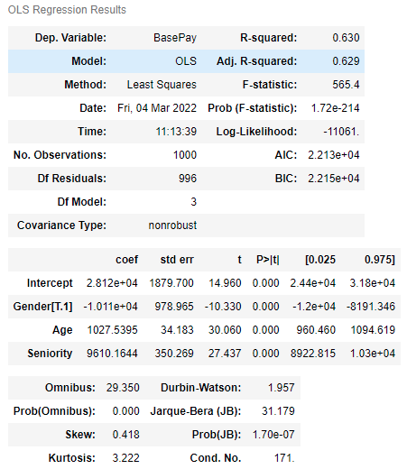
Multiple Regression Analysis
Model includes 3 variables
All variables have significant p-values
Prob(F-statistic) shows the model has a significant p-value
Adjusted R squared shows a moderate power of prediction at about 63%

